Slide 1
Deep Learning for Biology
Joris Roels

Slide 2
Convolutional Neural Networks

Slide 3
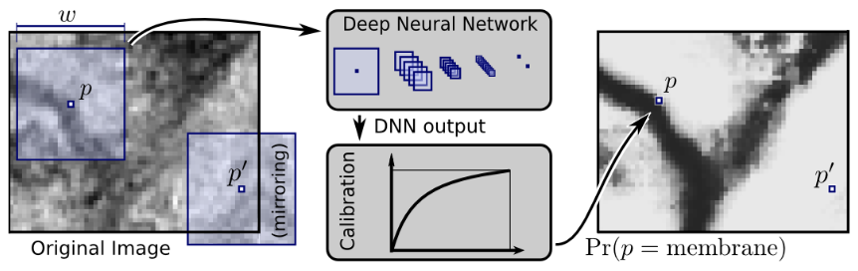

Overview
Introduction
Convolution
Convolutional Neural Networks for Classification
Exercises
Convolutional Neural Networks for Segmentation
Exercises

Slide 4
Introduction

Slide 5

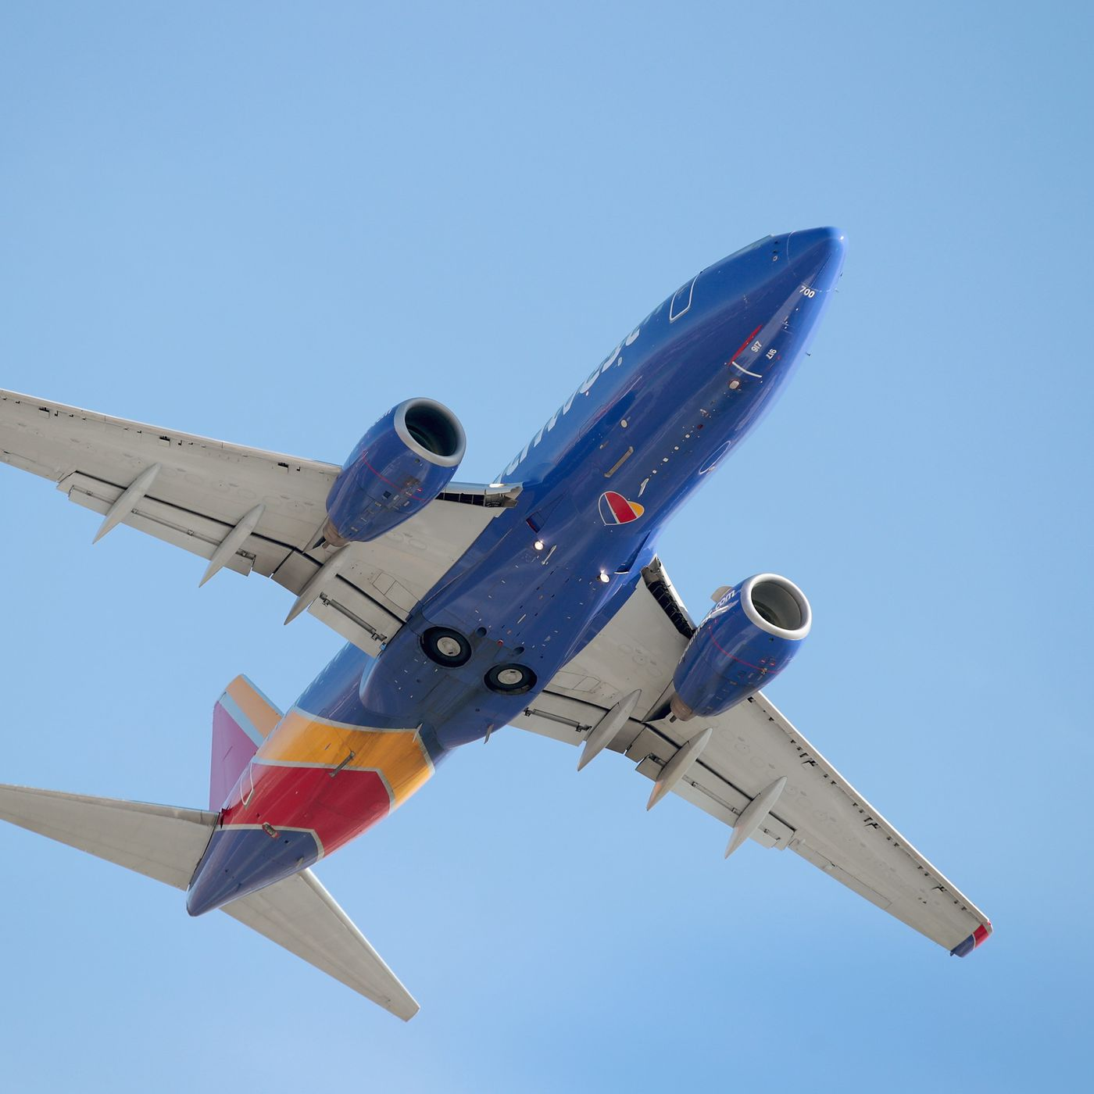
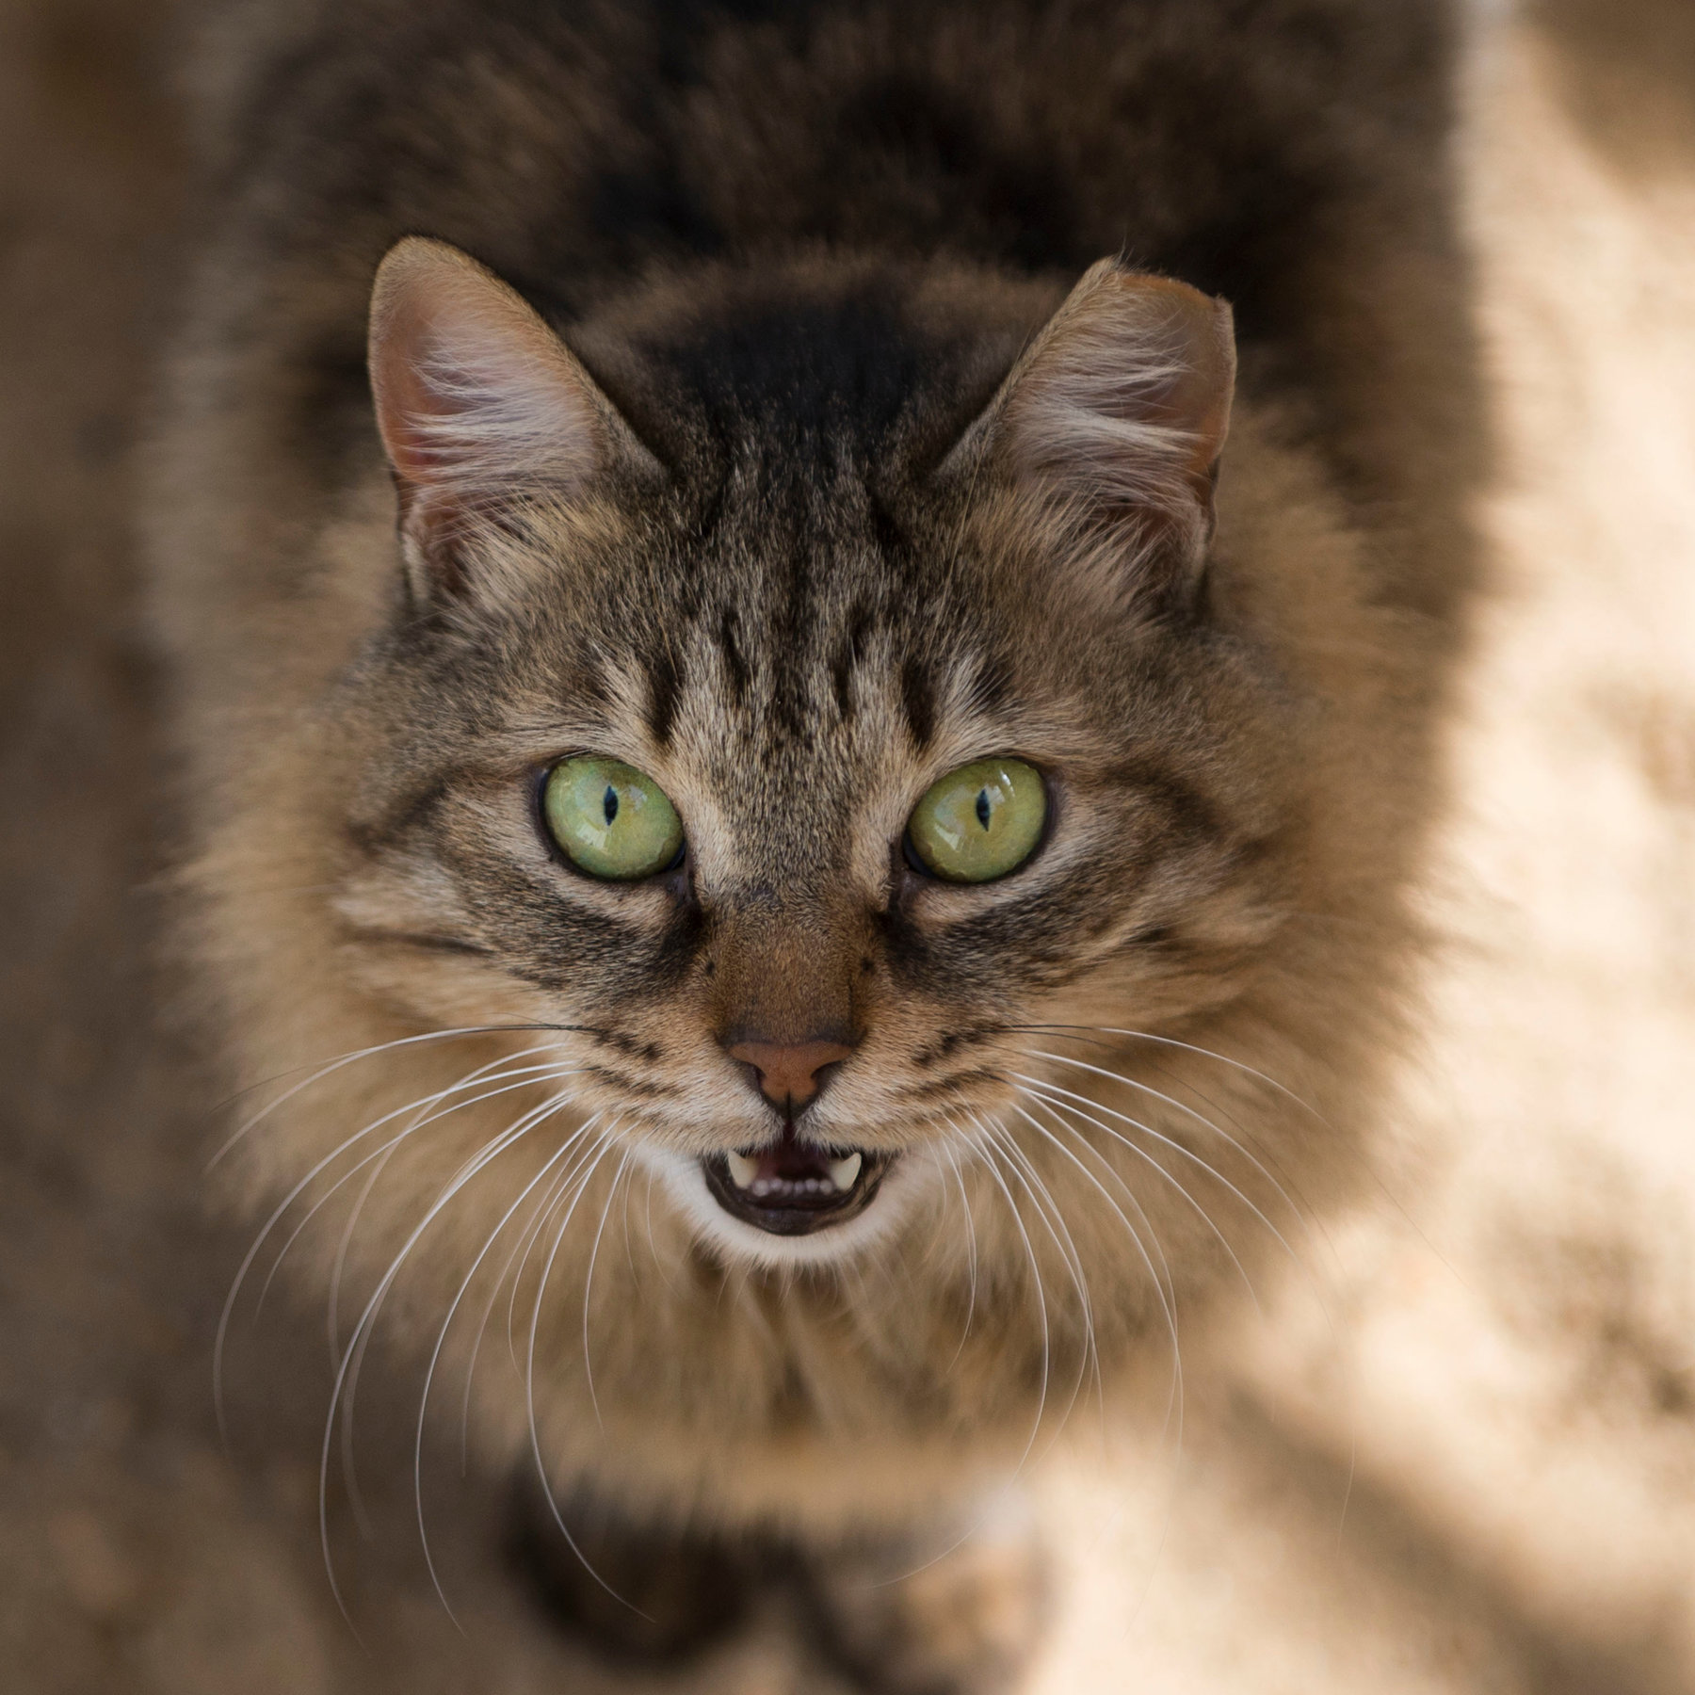
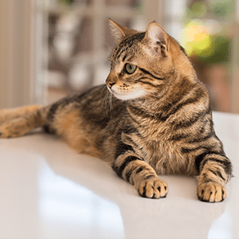
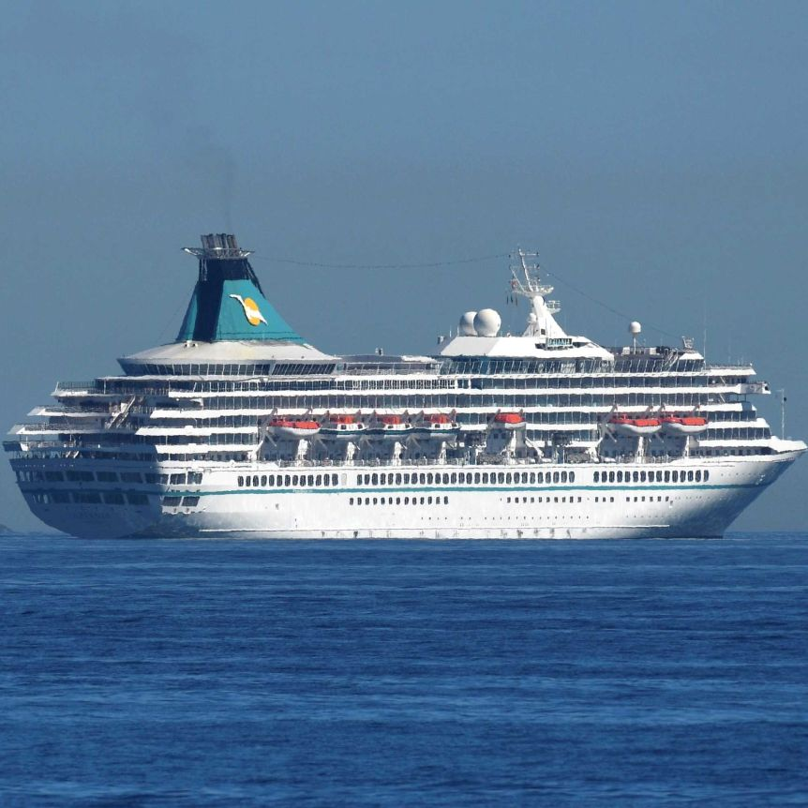
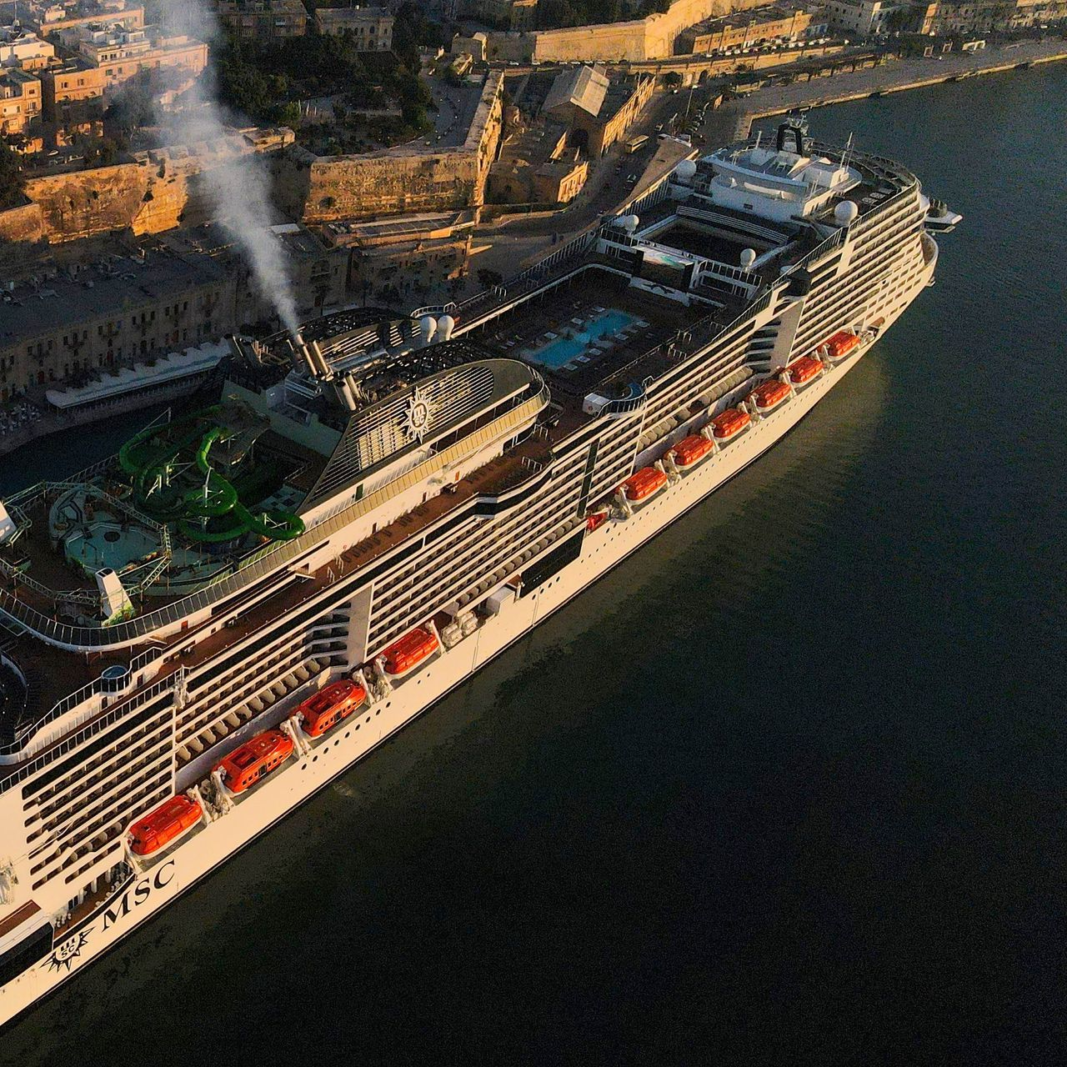

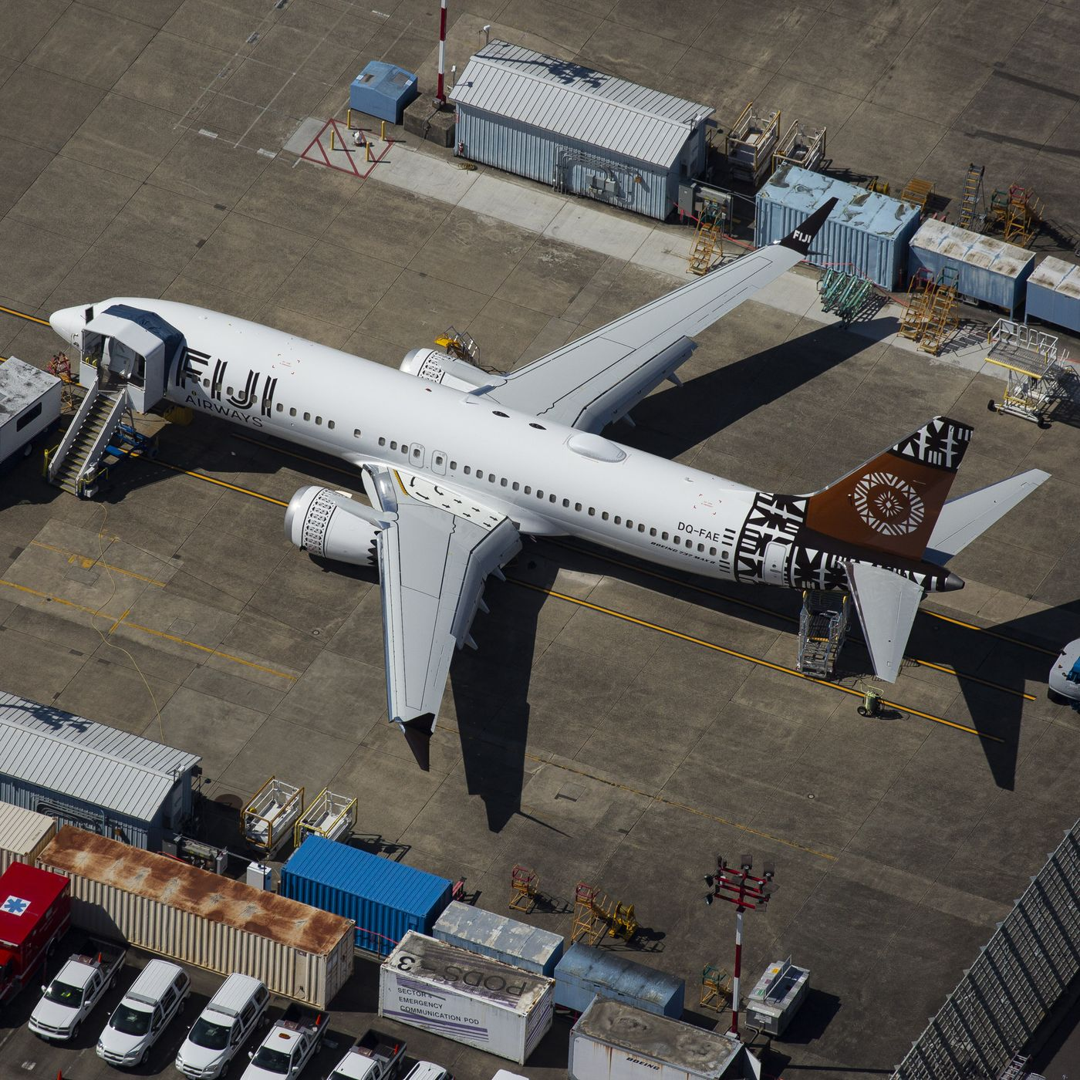
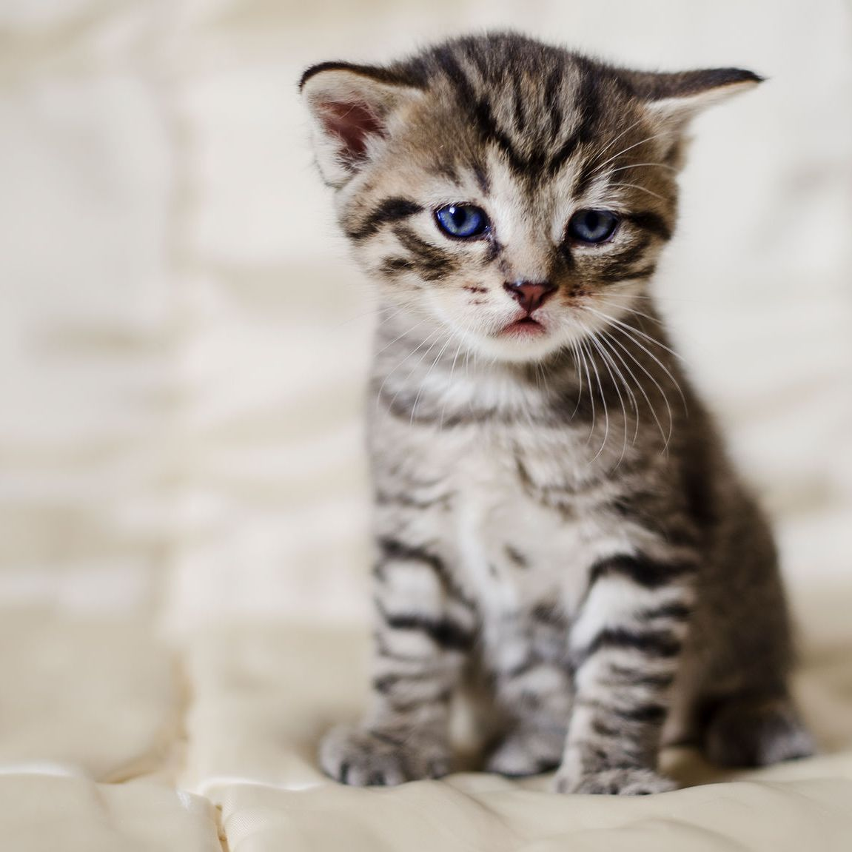
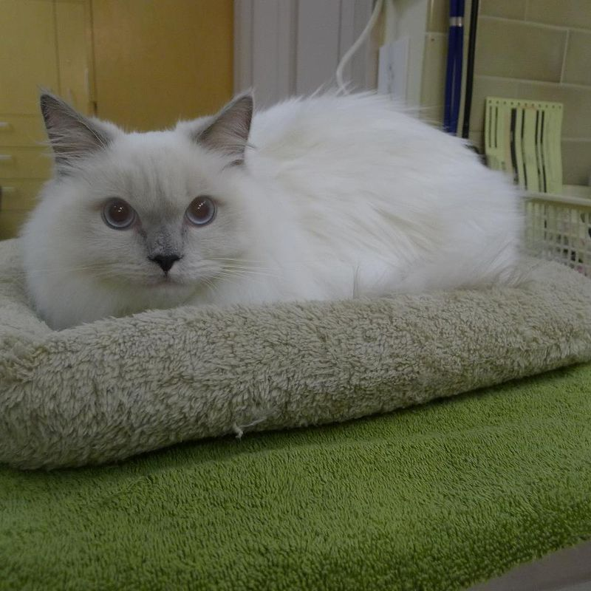
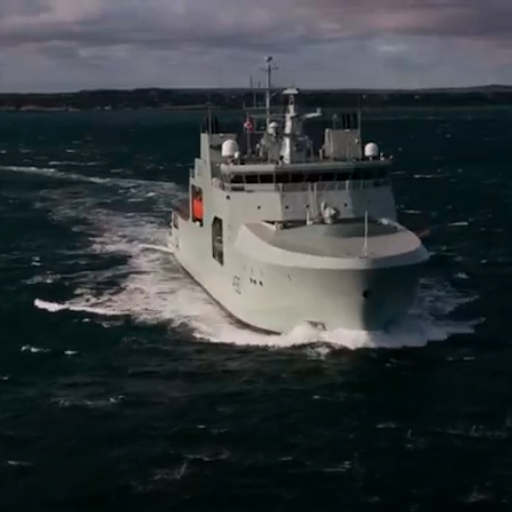
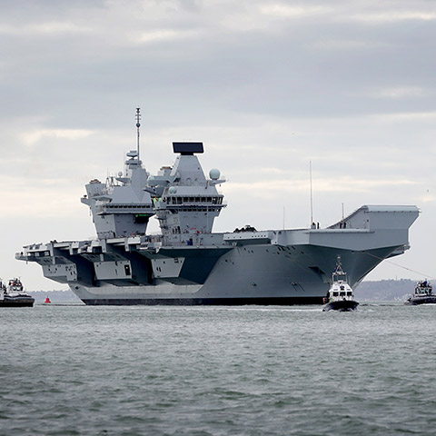



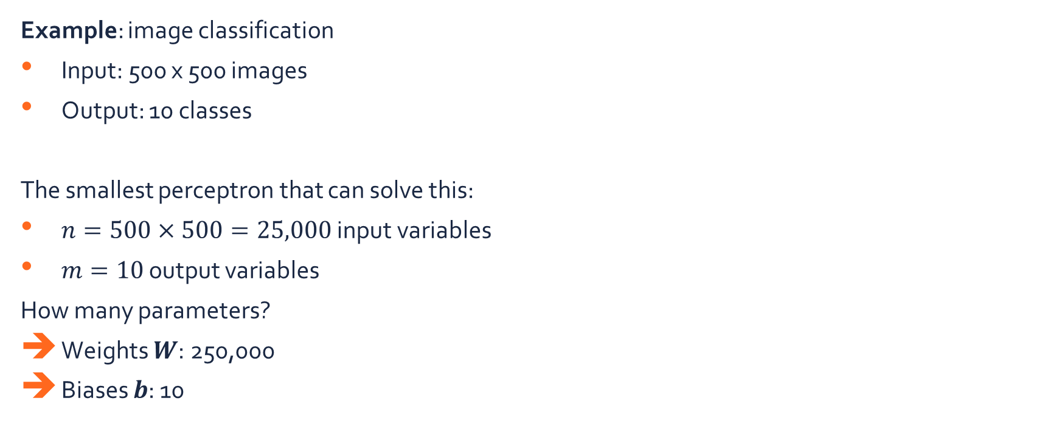




Introduction
Airplane
Cat
Ship
Example: image classification
Input: 500 x 500 images
Output: 10 classes
The smallest perceptron that can solve this:
$n=500×500=25,000$ input variables
$m=10$ output variables
How many parameters?
Weights $W$: 250,000
Biases $b$: 10
$x_{1}$
$y_{1}$
$x_{2}$
$y_{2}$
$$…$$
$$…$$
$x_{n}$
$y_{m}$

Slide 6



Introduction
Are all these connections really necessary?
Pixels nearby are correlated
Features in the image should not depend on the position
$y_{1}$
$$…$$
$y_{2}$
$$…$$
$y_{10}$

Slide 7
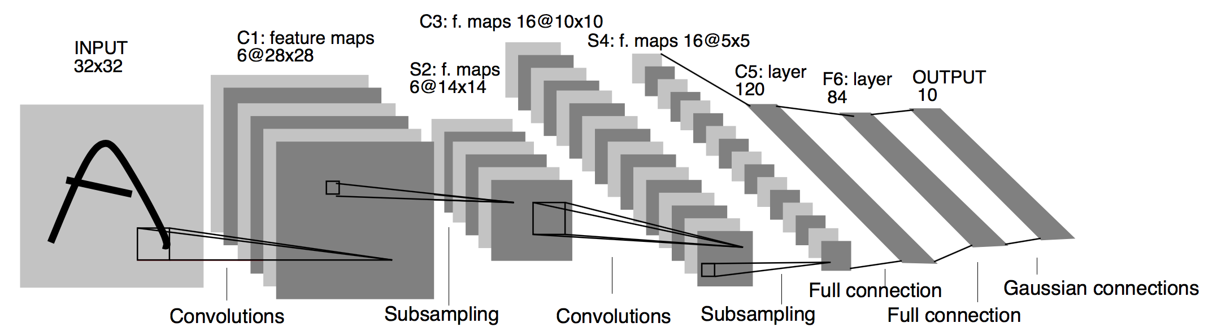
Introduction
Convolutional neural network (CNN):
Designed for fixed-size, grid-structured data
Image (2D, 3D, …)
Audio
Time-series
…
Exploit natural properties in these data:
Shift invariance
Weight sharing
Pooling
Inspired by biological processes (Hubel & Wiesel, 1962)
Work of LeCun et.al., 1998 initiated a massive research switch towards CNNs

Slide 8
Convolution

Slide 9

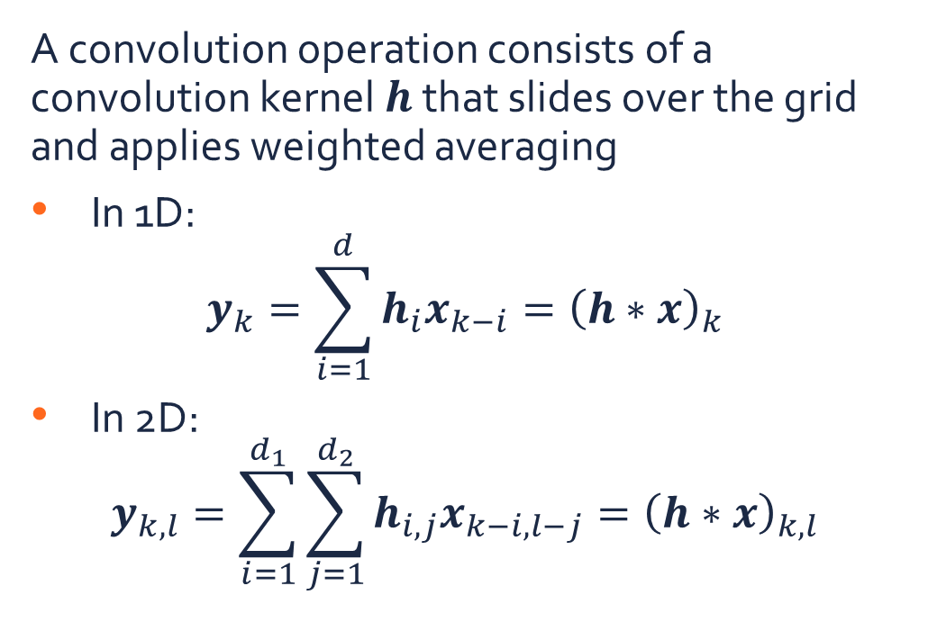

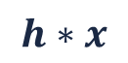

Convolution
A convolution operation consists of a convolution kernel $h$ that slides over the grid and applies weighted averaging
In 1D:
$$y_{k}=\sum_{i=1}^{d}{h_{i}x_{k−i}}={\left(h∗x\right)}_{k}$$
In 2D:
$$y_{k,l}=\sum_{i=1}^{d_{1}}{\sum_{j=1}^{d_{2}}{h_{i,j}x_{k−i,l−j}}}={\left(h∗x\right)}_{k,l}$$
$$h∗x$$
$$h$$
$$x$$

Slide 10
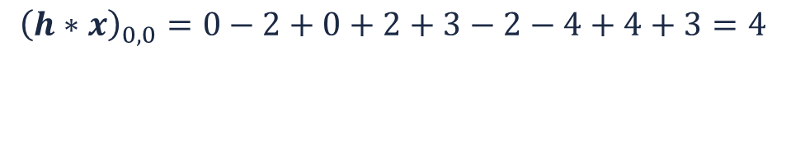



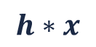

Convolution
$${\left(h∗x\right)}_{0,0}=0−2+0+2+3−2−4+4+3=4$$
Example:
1 | 2 | 1 | 0
2 | 3 | 2 | 1
2 | 2 | 3 | 2
2 | 3 | 3 | 4
0 | -1 | 0
1 | 1 | -1
-2 | 2 | 1
0 | -1 | 0
1 | 1 | -1
-2 | 2 | 1
4
$$∗$$
$$=$$
$$h$$
$$h∗x$$
$$x$$

Slide 11
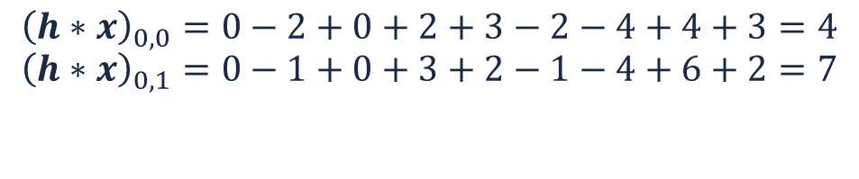
Convolution
$${\left(h∗x\right)}_{0,0}=0−2+0+2+3−2−4+4+3=4$$
$${\left(h∗x\right)}_{0,1}=0−1+0+3+2−1−4+6+2=7$$
Example:
1 | 2 | 1 | 0
2 | 3 | 2 | 1
2 | 2 | 3 | 2
2 | 3 | 3 | 4
0 | -1 | 0
1 | 1 | -1
-2 | 2 | 1
0 | -1 | 0
1 | 1 | -1
-2 | 2 | 1
4
7
$$∗$$
$$=$$
$$h$$
$$h∗x$$
$$x$$

Slide 12
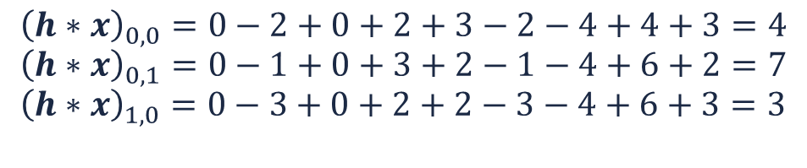
Convolution
$${\left(h∗x\right)}_{0,0}=0−2+0+2+3−2−4+4+3=4$$
$${\left(h∗x\right)}_{0,1}=0−1+0+3+2−1−4+6+2=7$$
$${\left(h∗x\right)}_{1,0}=0−3+0+2+2−3−4+6+3=3$$
Example:
1 | 2 | 1 | 0
2 | 3 | 2 | 1
2 | 2 | 3 | 2
2 | 3 | 3 | 4
0 | -1 | 0
1 | 1 | -1
-2 | 2 | 1
0 | -1 | 0
1 | 1 | -1
-2 | 2 | 1
4
7
$$∗$$
$$=$$
3
$$h$$
$$h∗x$$
$$x$$

Slide 13
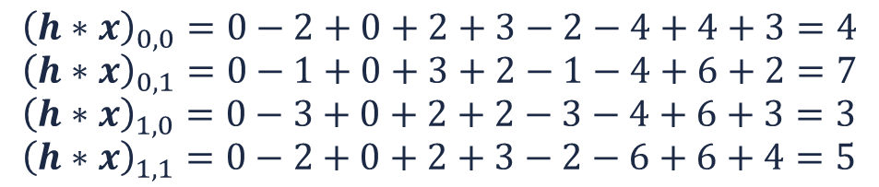
Convolution
$${\left(h∗x\right)}_{0,0}=0−2+0+2+3−2−4+4+3=4$$
$${\left(h∗x\right)}_{0,1}=0−1+0+3+2−1−4+6+2=7$$
$${\left(h∗x\right)}_{1,0}=0−3+0+2+2−3−4+6+3=3$$
$${\left(h∗x\right)}_{1,1}=0−2+0+2+3−2−6+6+4=5$$
Example:
1 | 2 | 1 | 0
2 | 3 | 2 | 1
2 | 2 | 3 | 2
2 | 3 | 3 | 4
0 | -1 | 0
1 | 1 | -1
-2 | 2 | 1
0 | -1 | 0
1 | 1 | -1
-2 | 2 | 1
4
7
$$∗$$
$$=$$
3
5
$$h$$
$$h∗x$$
$$x$$

Slide 14
Convolution
Example:
1 | 2 | 1 | 0
2 | 3 | 2 | 1
2 | 2 | 3 | 2
2 | 3 | 3 | 4
0 | -1 | 0
1 | 1 | -1
-2 | 2 | 1
4
7
$$∗$$
$$=$$
3
5
$$h$$
$$h∗x$$
$$x$$

Slide 15
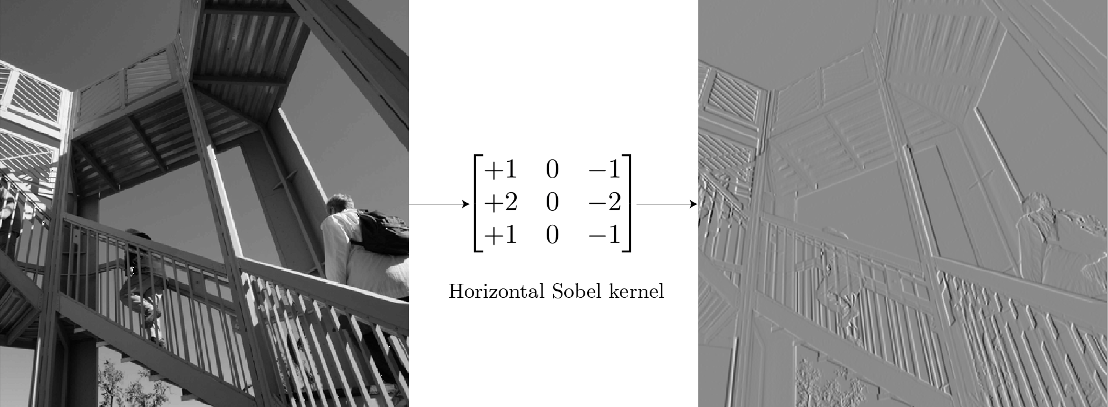
Convolution
Example:

Slide 16

Convolution
Padding:
The convolution kernels cannot go beyond the edges
➔ Output dimensions are smaller
Create fictive values beyond the edges
Zero
Reflection
Replication
Circular

Slide 17

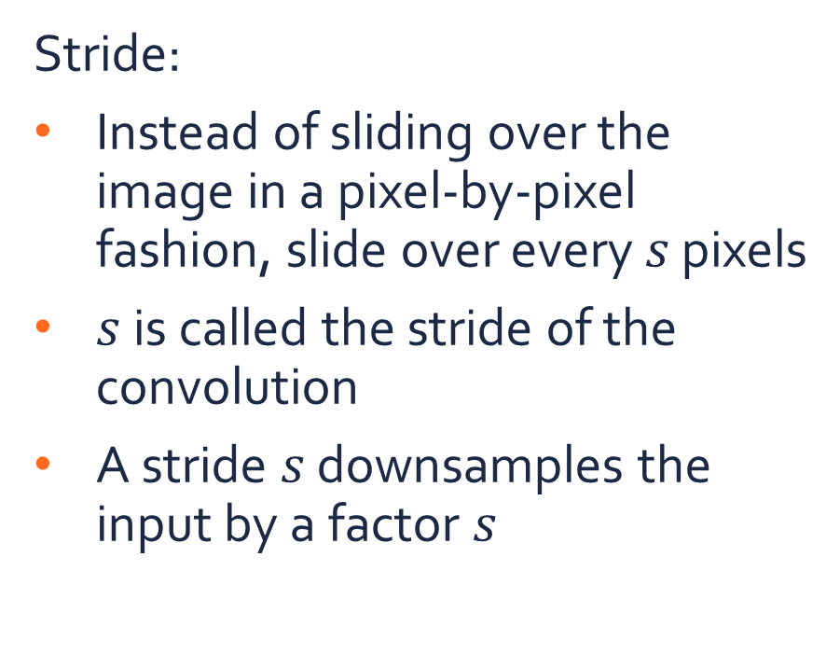
Convolution
Stride:
Instead of sliding over the image in a pixel-by-pixel fashion, slide over every $s$ pixels
$s$ is called the stride of the convolution
A stride $s$ downsamples the input by a factor $s$

Slide 18

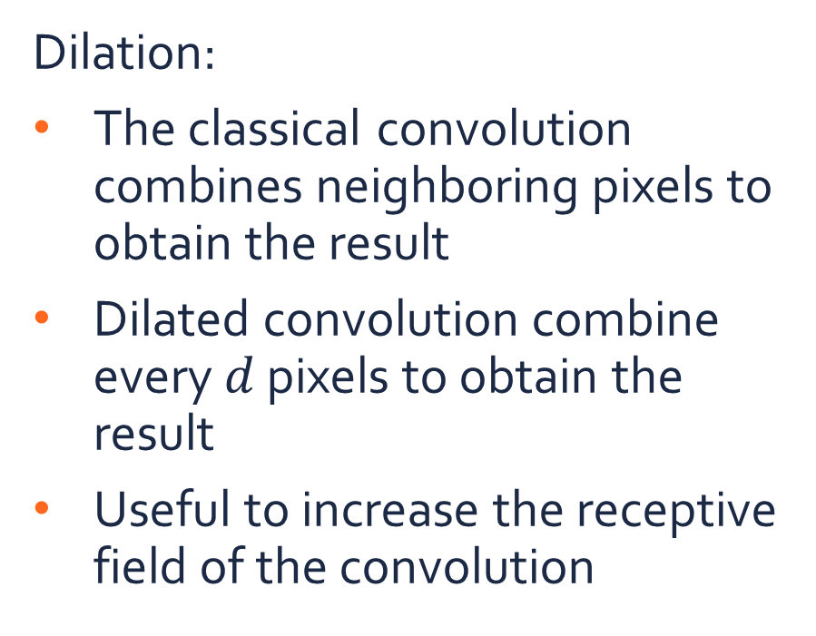
Convolution
Dilation:
The classical convolution combines neighboring pixels to obtain the result
Dilated convolution combine every $d$ pixels to obtain the result
Useful to increase the receptive field of the convolution

Slide 19


Convolution
Example: kernel size, padding, stride, dilation?
Kernel size: 3
Padding: 1
Stride: 2
Dilation: 1
Kernel size: 3
Padding: 2
Stride: 1
Dilation: 1
Kernel size: 3
Padding: 0
Stride: 1
Dilation: 2

Slide 20
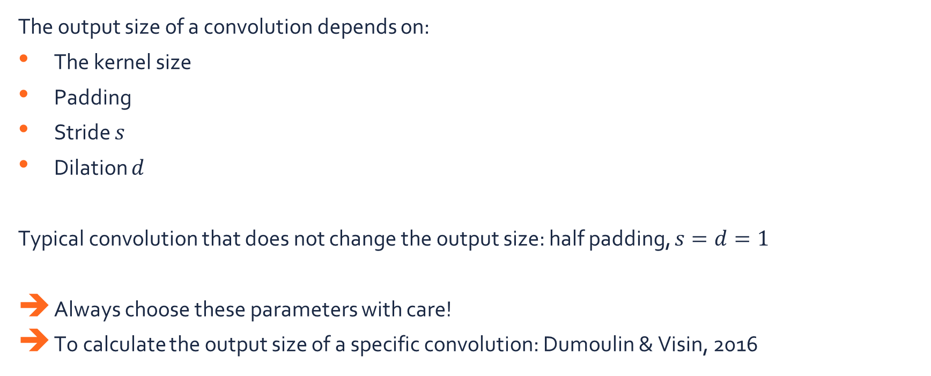
Convolution
The output size of a convolution depends on:
The kernel size
Padding
Stride $s$
Dilation $d$
Typical convolution that does not change the output size: half padding, $s=d=1$
Always choose these parameters with care!
To calculate the output size of a specific convolution: Dumoulin & Visin, 2016

Slide 21
Convolutional Neural Networks for Classification

Slide 22

Convolutional neural network
A convolutional neural network (CNN) consists of:
A feature extractor:
Convolutional layers,
Non-linear activations
Pooling layers
A classifier: an MLP that make the prediction

Slide 23



Convolutional layer
Are all these connections really necessary?
Pixels nearby are correlated
Features in the image should not depend on the position
$h_{1}$
$$…$$
$h_{2}$
$$…$$
$h_{l}$

Slide 24
Convolutional layer
Convolution operation can solve this issue:
Local correlations are modeled by convolution kernels
Spatial invariance follows from the convolution operation
$h_{1}$
$h_{2}$
$$…$$
$h_{l}$

Slide 25
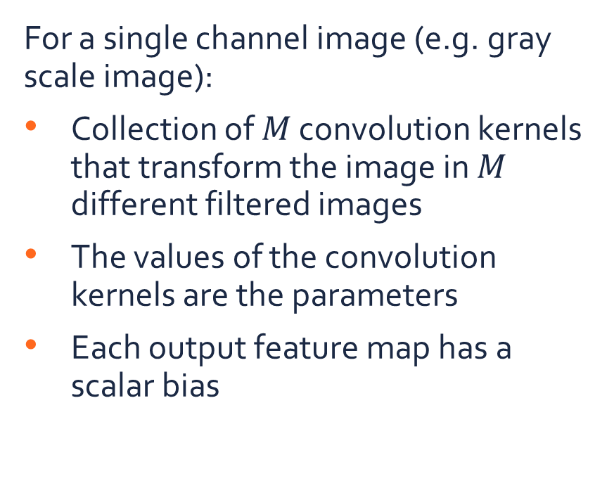
Convolutional layer
Input
Convolution kernels
…
For a single channel image (e.g. gray scale image):
Collection of $M$ convolution kernels that transform the image in $M$ different filtered images
The values of the convolution kernels are the parameters
Each output feature map has a scalar bias
Output
…

Slide 26
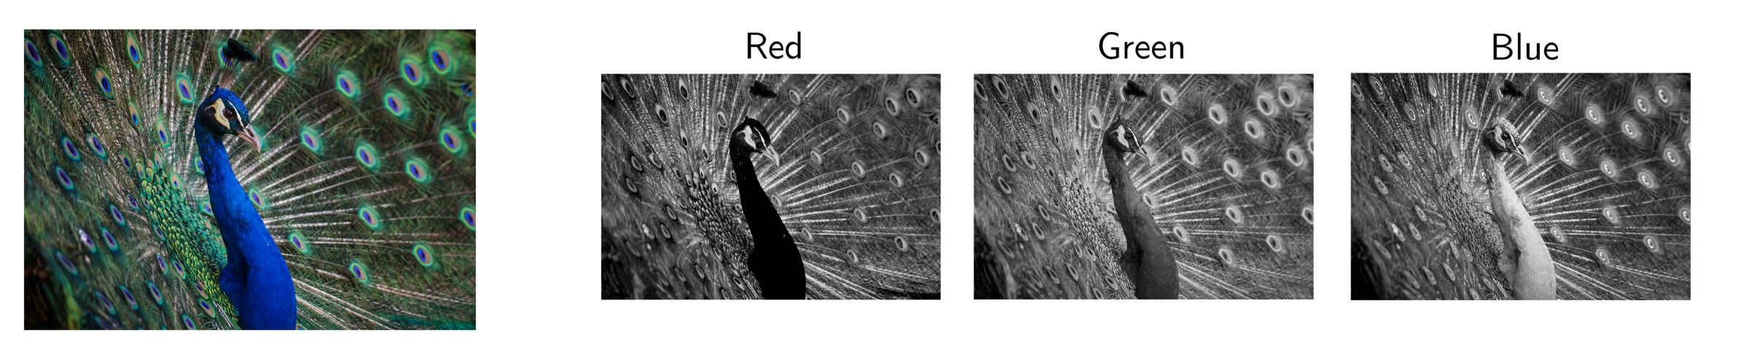
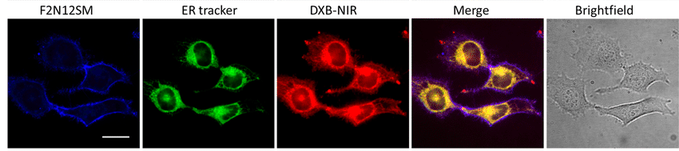
Convolutional layer
In practice, we have multi-channel data

Slide 27
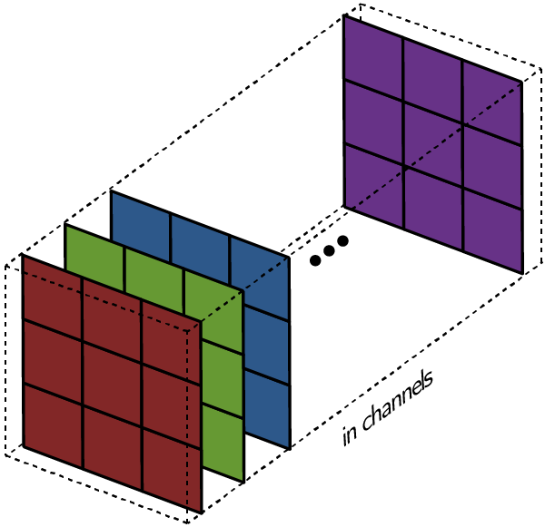
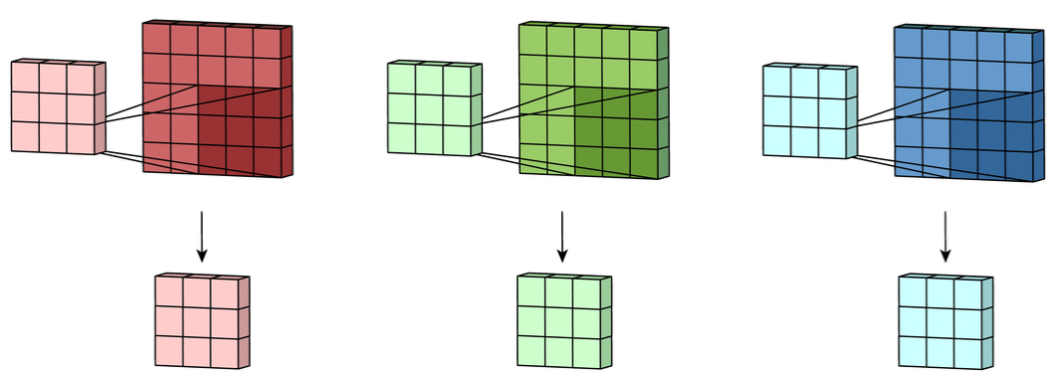
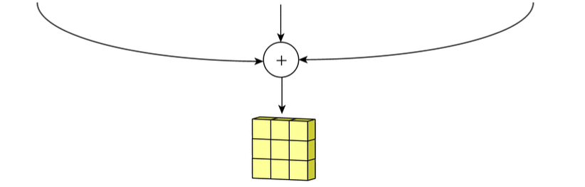
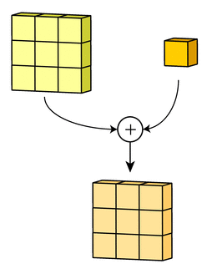
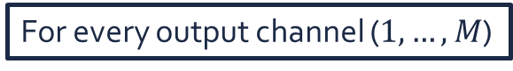
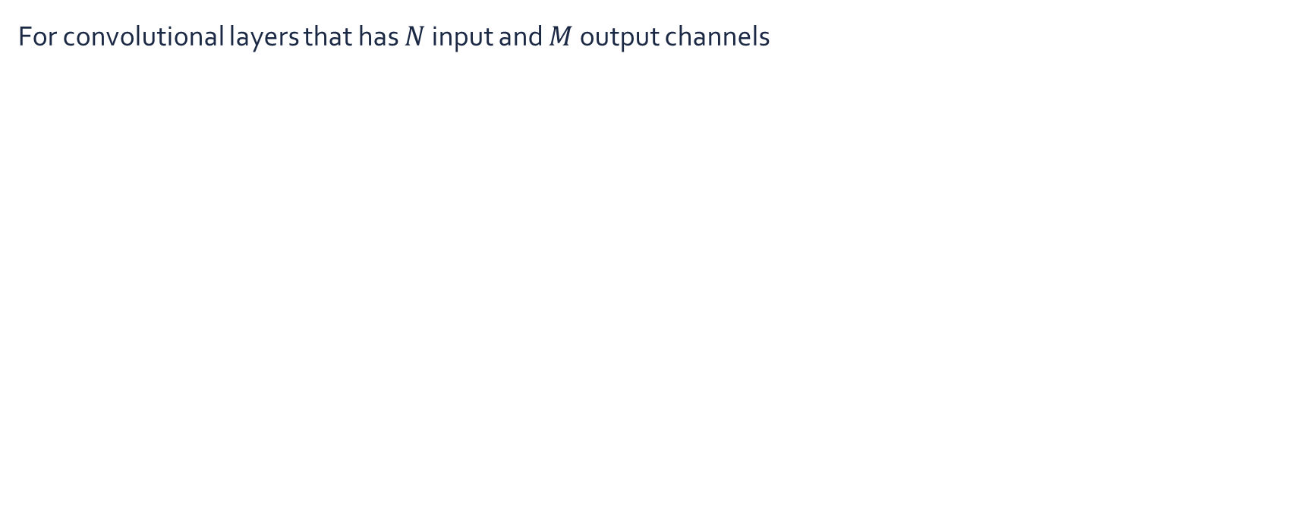



Convolutional layer
For convolutional layers that has $N$ input and $M$ output channels
For every output channel ($1,…,M$)
(1) Apply a convolution on each input channel
Input
(3) Add a bias term
$$Y$$
$$N$$
(2) Sum the results
$$X$$

Slide 28
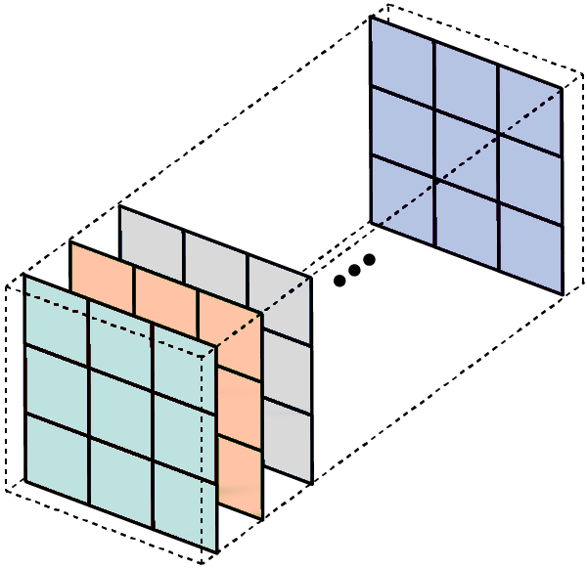

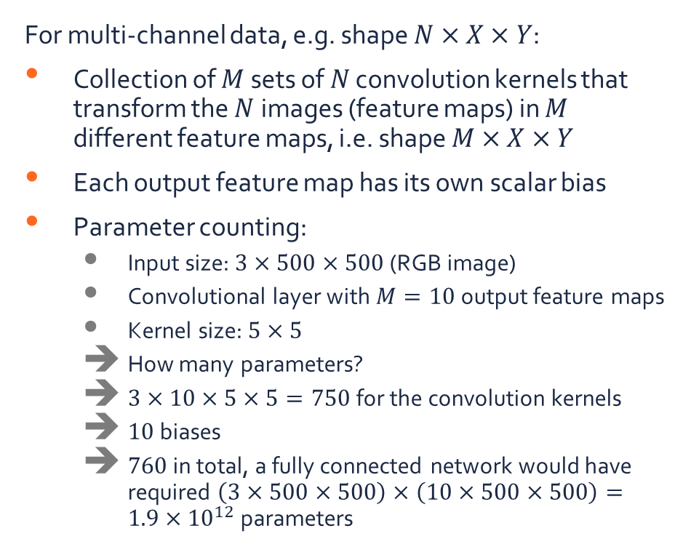





Convolutional layer
For multi-channel data, e.g. shape $N×X×Y$:
Collection of $M$ sets of $N$ convolution kernels that transform the $N$images (feature maps) in $M$ different feature maps, i.e. shape $M×X×Y$
Each output feature map has its own scalar bias
Parameter counting:
Input size: $3×500×500$ (RGB image)
Convolutional layer with $M=10$ output feature maps
Kernel size: $5×5$
How many parameters?
$3×10×5×5=750$ for the convolution kernels
$10$ biases
$760$ in total, a fully connected network would have required $\left(3×500×500\right)×\left(10×500×500\right)=1.9×{10}^{12}$ parameters
$$Y$$
$$N$$
…
$$X$$
…
…
…
…
$$Y$$
$$M$$
$$X$$

Slide 29
Convolutional neural network
A convolutional neural network (CNN) consists of:
A feature extractor:
Convolutional layers,
Non-linear activations
Pooling layers
A classifier: an MLP that make the prediction

Slide 30
Pooling layer
Images are high-dimensional
Every pixel corresponds to a dimension
In order to obtain a (low-dimensional) class prediction, we have to reduce the dimensionality of the feature maps
Select the most important features
Pooling: aggregate local activations to downsample the data
Average pooling
Max pooling
…
…

Slide 31
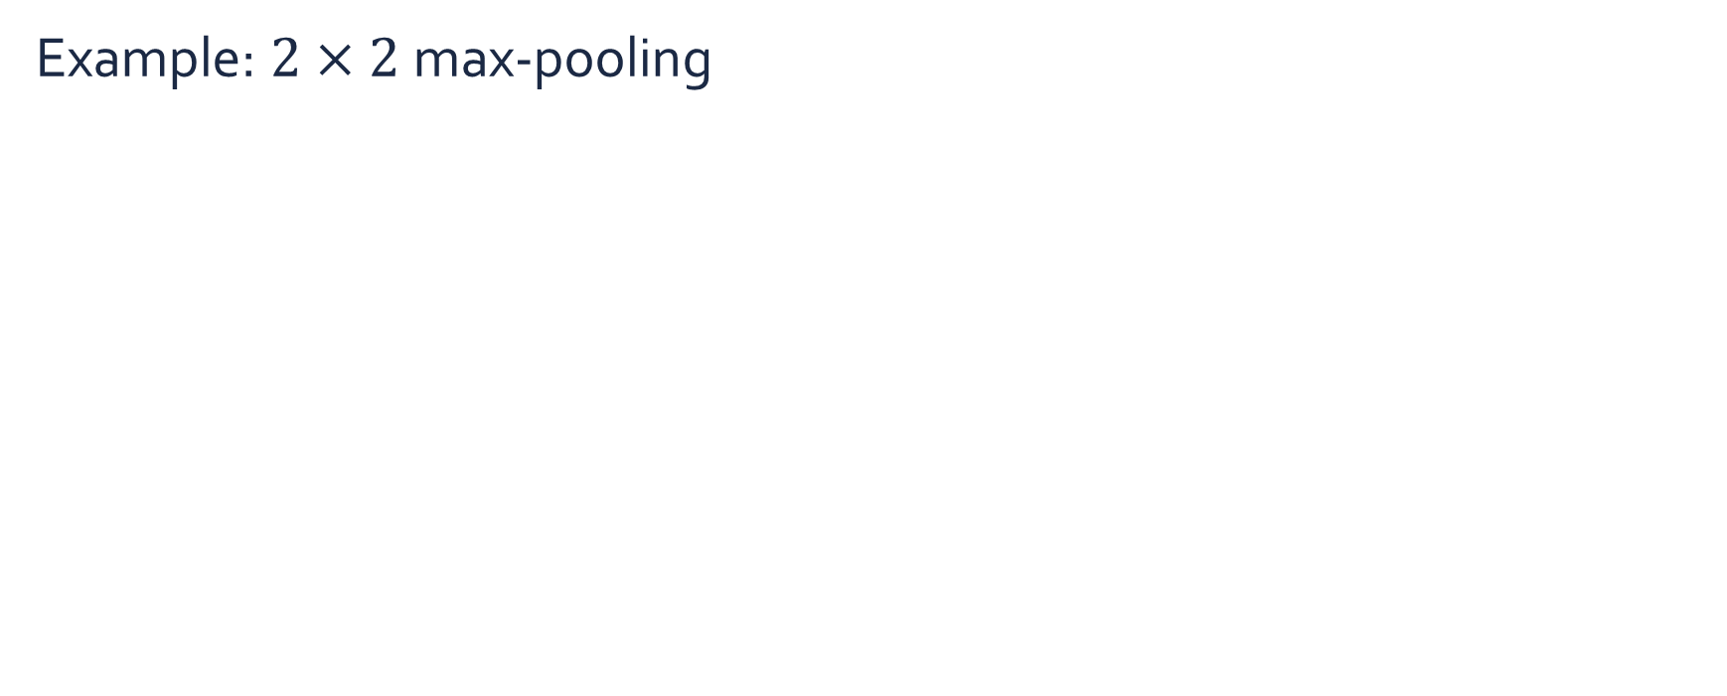
Pooling layer
Example: $2×2$ max-pooling
1 | 2 | 1 | 0
2 | 3 | 2 | 1
2 | 2 | 3 | 2
2 | 3 | 3 | 4
3

Slide 32
Pooling layer
Example: $2×2$ max-pooling
1 | 2 | 1 | 0
2 | 3 | 2 | 1
2 | 2 | 3 | 2
2 | 3 | 3 | 4
3 | 2

Slide 33
Pooling layer
Example: $2×2$ max-pooling
1 | 2 | 1 | 0
2 | 3 | 2 | 1
2 | 2 | 3 | 2
2 | 3 | 3 | 4
3 | 2
3

Slide 34
Pooling layer
Example: $2×2$ max-pooling
1 | 2 | 1 | 0
2 | 3 | 2 | 1
2 | 2 | 3 | 2
2 | 3 | 3 | 4
3 | 2
3 | 4

Slide 35
Convolutional neural network
A convolutional neural network (CNN) consists of:
A feature extractor:
Convolutional layers,
Non-linear activations
Pooling layers
A classifier: an MLP that make the prediction
Many different architectures have been proposed in recent literature

Slide 36

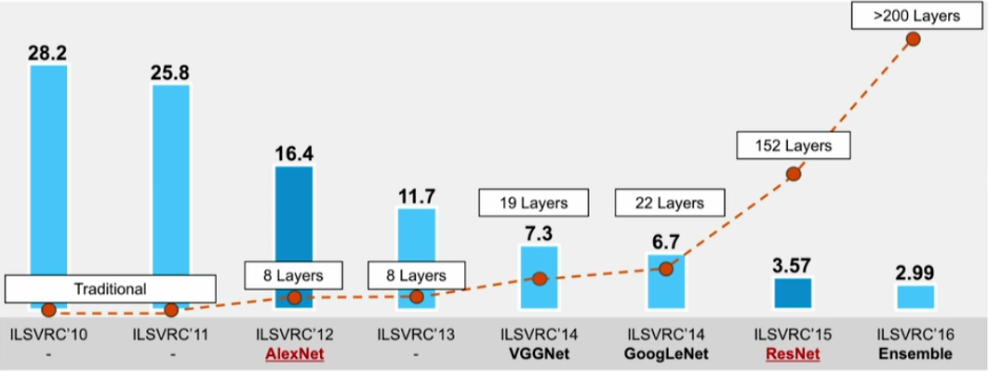
Convolutional neural network
Large amounts of layers allows for more variability in the extracted features and better generalization
ImageNet image classification challenge
Classification error on ImageNet
14M labeled images / 300 GB
27 high-level classes (plant, geological formation, …)
22K low-level classes (tree, grass, ice mass, monocline)

Slide 37

Convolutional neural network
Novelties:
ReLU
Dropout
Data augmentation
Deeper
AlexNet (Krizhevsky et.al., 2012)

Slide 38

Convolutional neural network
Novelties:
Deeper
VGG (Simonyan et.al., 2015)

Slide 39
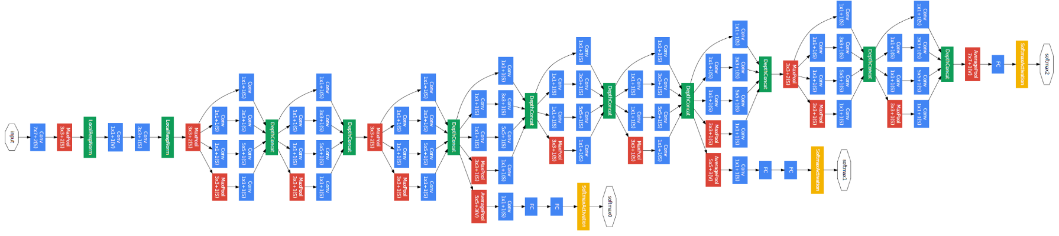
Convolutional neural network
Novelties:
Repetitive modules
Batch normalization
Deeper
Inception (Szegedy et.al., 2015)

Slide 40
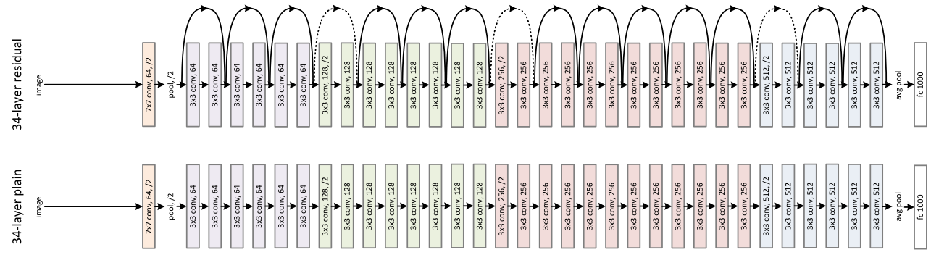
Convolutional neural network
Novelties:
Residual layers
Deeper
ResNet (He et.al., 2016)

Slide 41

Convolutional neural network
Extracted features

Slide 42
Summary
Convolutional neural networks (CNN) are a special case of MLPs
Local connectivity
Weight sharing
Pooling
Many layers
Much more efficient for grid-structured data compared to MLPs
Current state-of-the-art in many classification problems

Slide 43
Exercises

Slide 44
Exercises
Open the notebook in Google Colab:
https://colab.research.google.com/github/JorisRoels/deep-learning-biology/blob/main/exercises/assignments/2020-dlb-2-cnn-classification.ipynb
Make sure you are using a GPU: Runtime > Change Runtime Type > Select ‘GPU’
Move to your break-out room
Try to solve the exercises
After every exercise we will come back to the main room and discuss the results
The complete solution notebook will be uploaded at the end of the session
Ask questions to the assistants in the break-out room!

Slide 45
Convolutional Neural Networks for Segmentation

Slide 46
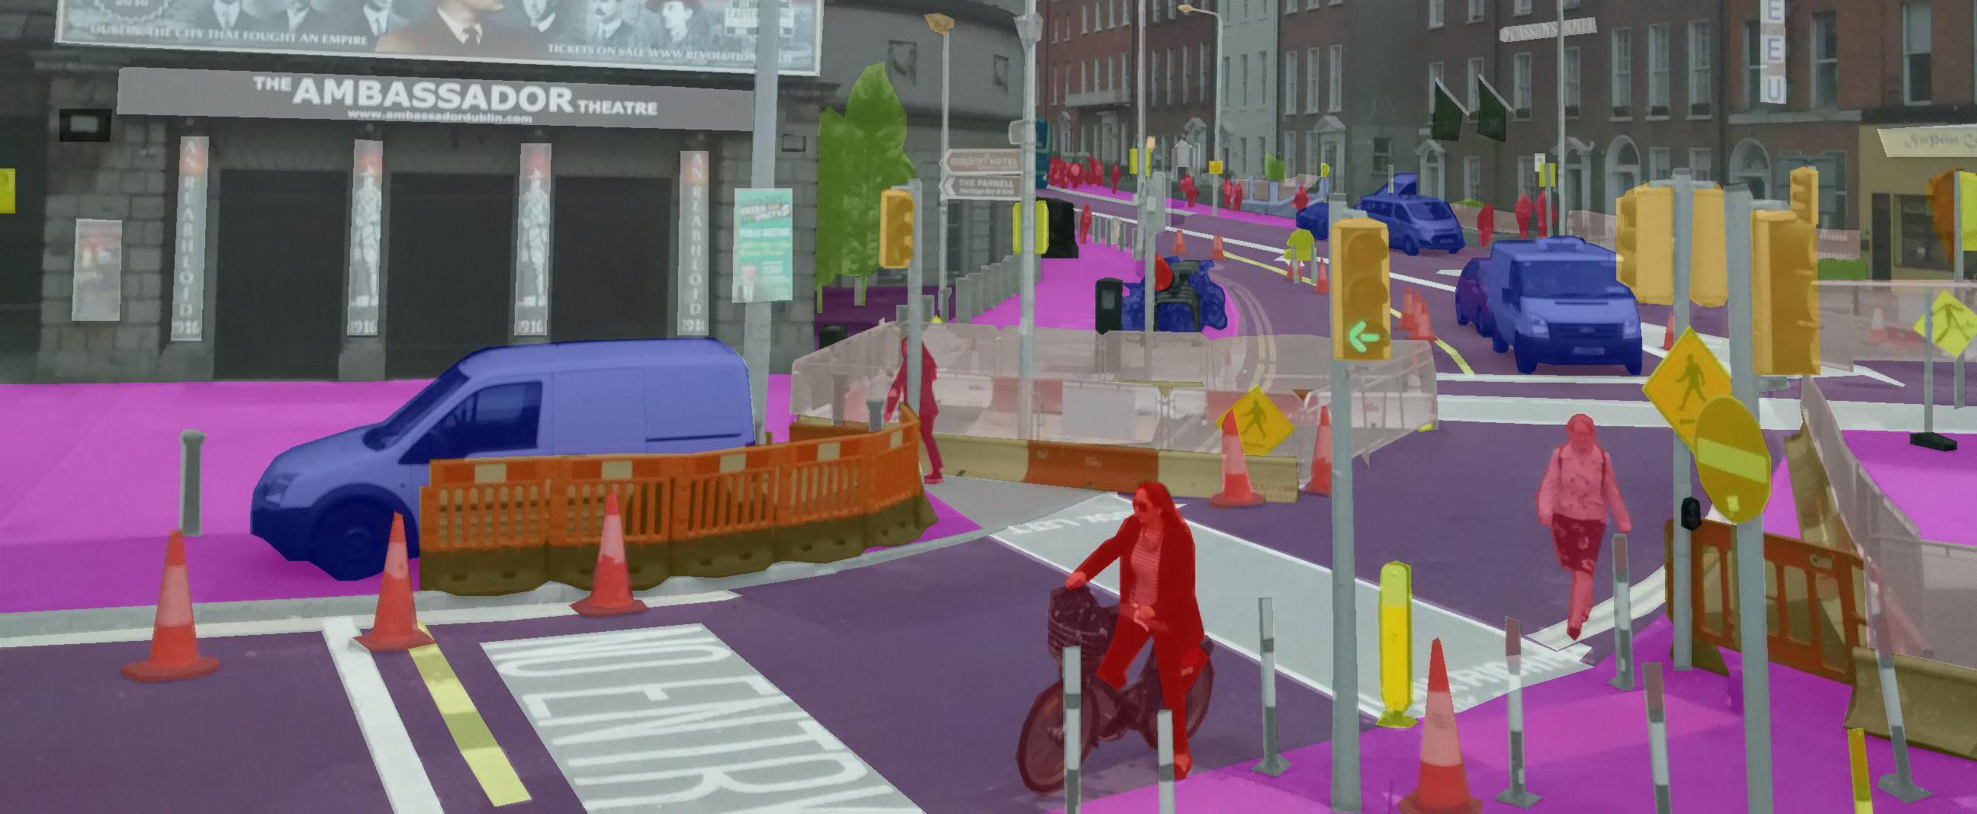
Semantic segmentation
Classify each pixel of an image to a particular class

Slide 47
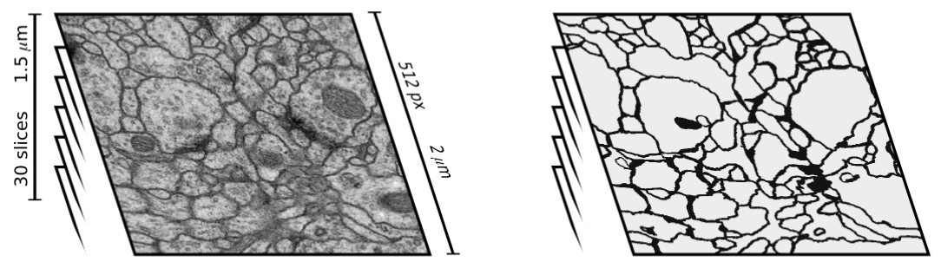
ISBI challenge 2012
Segmentation of neuronal structures in EM stacks

Slide 48
ISBI challenge 2012
Semantic segmentation = pixel classification (Ciresan et.al., 2012)

Slide 49
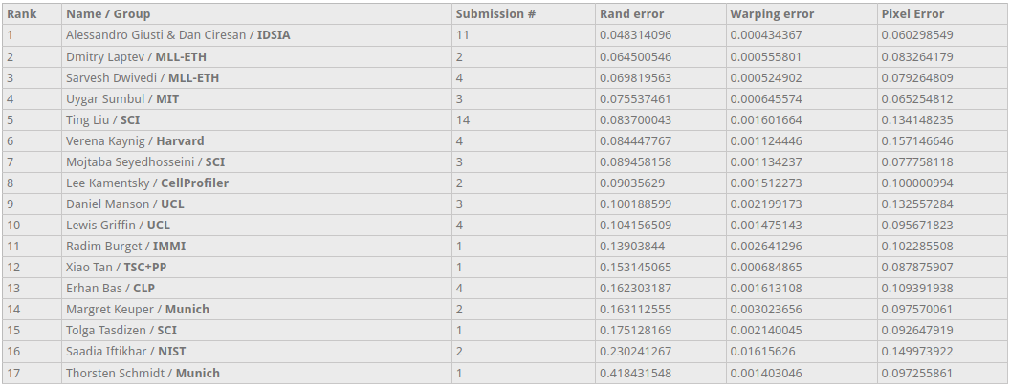
ISBI challenge 2012
Leaderboard

Slide 50
Pixel classification
Semantic segmentation as pixel classification has several disadvantages:
Every pixel has to be classified separately: computationally intensive!
Window size introduces a compute/accuracy trade off:
Small window size:
Computationally efficient
Limited context
Large window size:
Computationally inefficient
More context

Slide 51
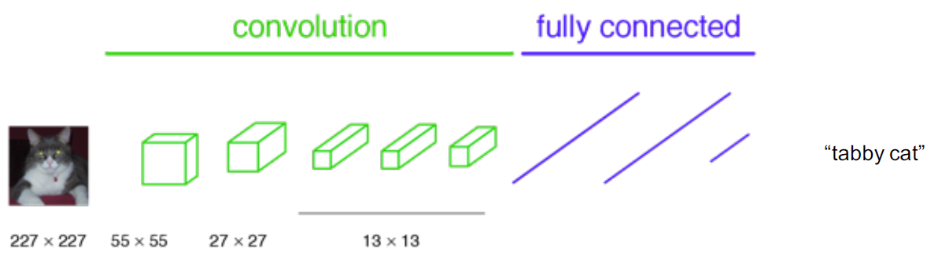
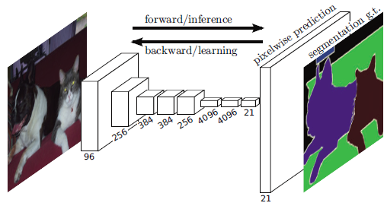
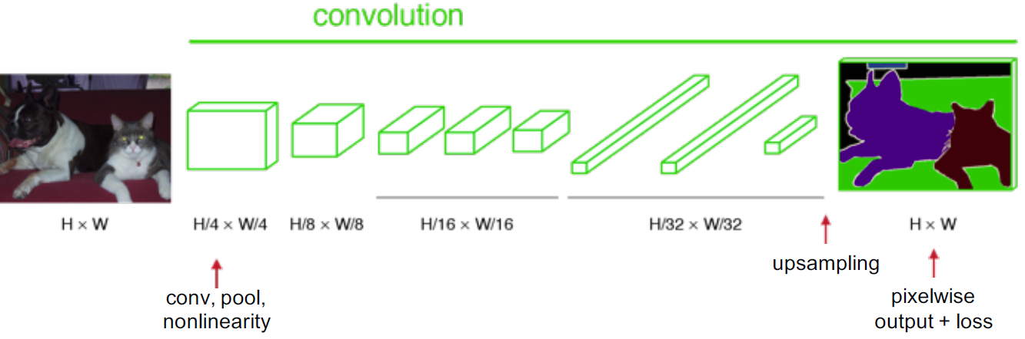
Fully convolutional networks
CNN for classification
CNN for segmentation (FCN):
No full connections, only convolutions
Transposed convolutions (upsampling)
FCN (Shelhamer et.al., 2017)

Slide 52
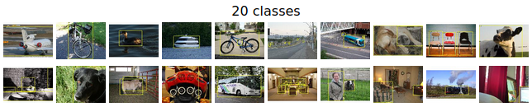
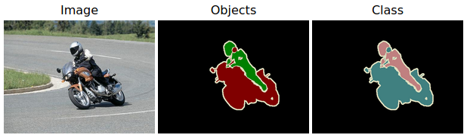
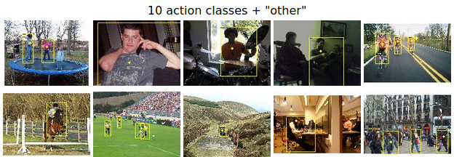
Pascal VOC 2012
Classification/detection competition
Segmentation competition
3000 labeled training images
7000 objects
20 classes
Action classification competition

Slide 53
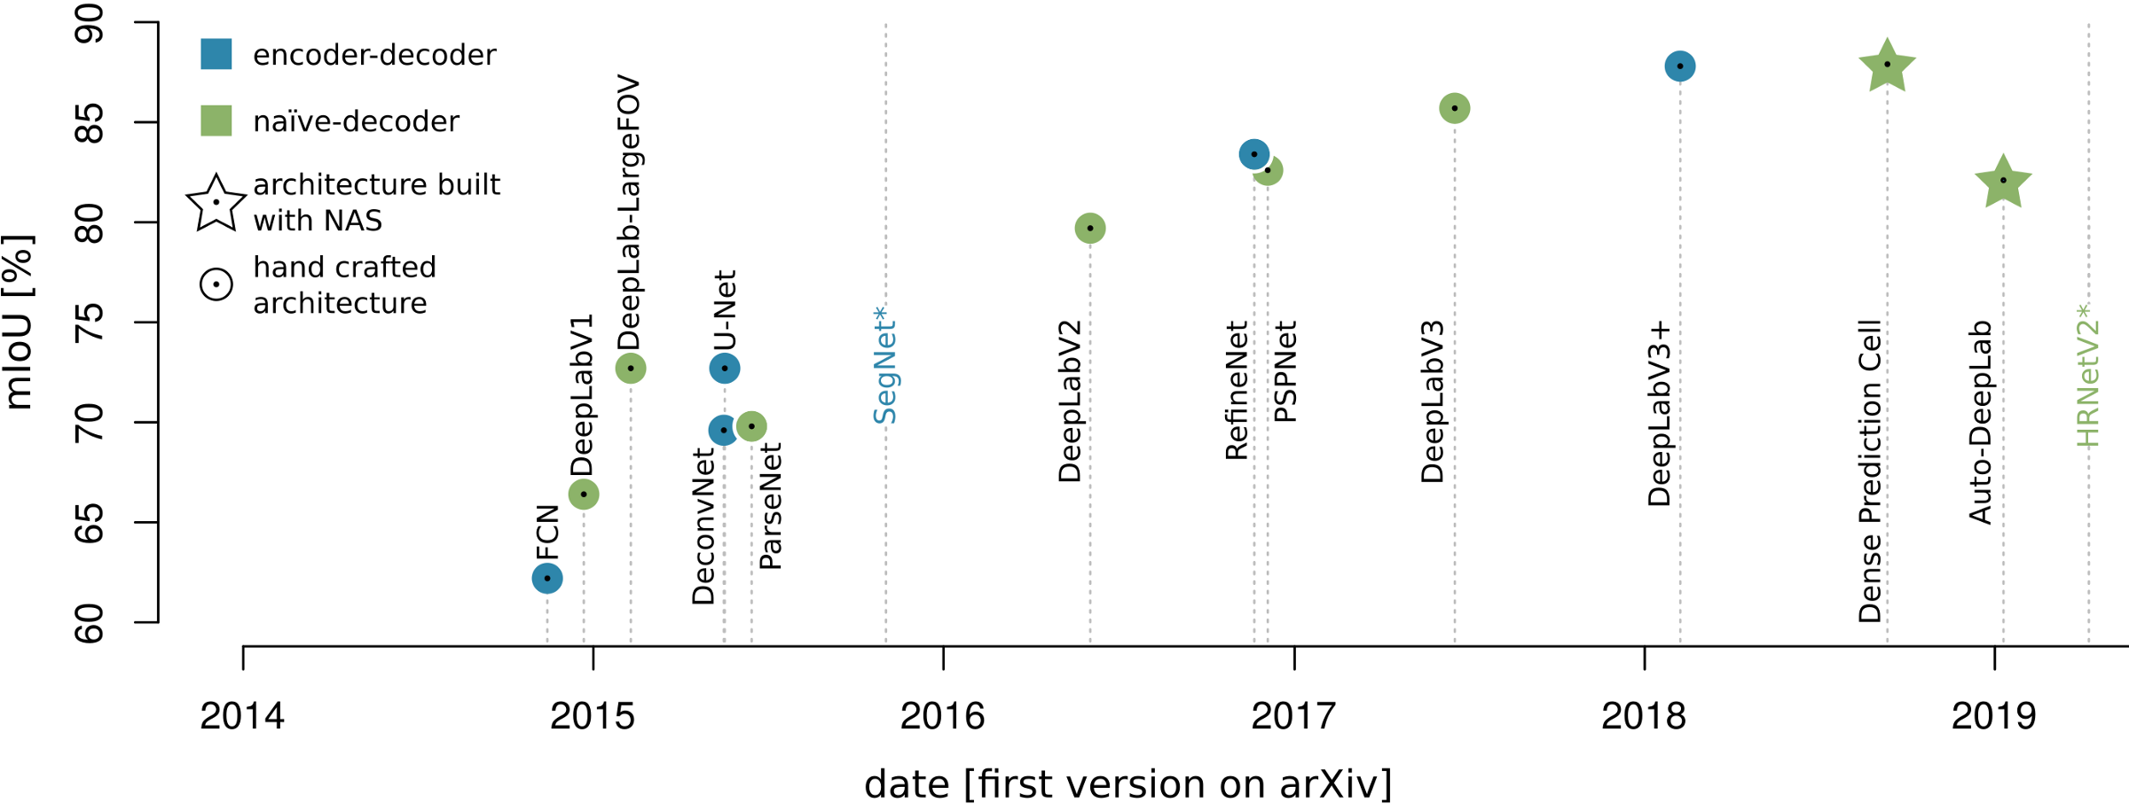
Pascal VOC

Slide 54
U-Net
Upsampling ignores the loss in resolution
U-Net (Ronneberger et.al., 2015):
Combine upsampling with convolutional layer
Introduce skip connections that restore high resolution information

Slide 55
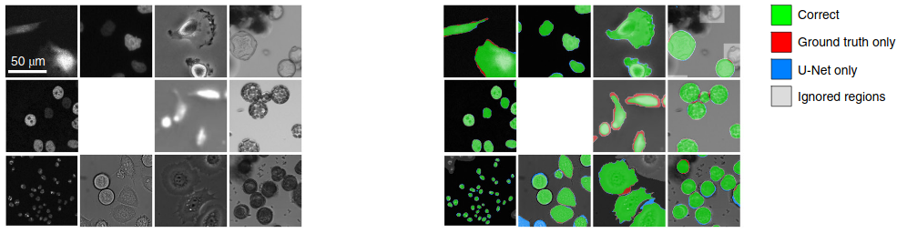


U-Net
Morphometric cell description
Up to know, state-of-the-art in biomedical segmentation
Cell morphometry in bright field data
Neurite tracing

Slide 56
Summary
Segmentation as pixel classification is insufficient
Segmentation requires a fundamentally different architecture with CNNs
Alternative architectures employ upsampling layers
State-of-the-art (in biomedical imaging) employ encoder-decoder layers (U-Net)

Slide 57
Exercises

Slide 58
Exercises
Open the notebook in Google Colab:
https://colab.research.google.com/github/JorisRoels/deep-learning-biology/blob/main/exercises/assignments/2020-dlb-3-cnn-segmentation.ipynb
Make sure you are using a GPU: Runtime > Change Runtime Type > Select ‘GPU’
Move to your break-out room
Try to solve the exercises
After every exercise we will come back to the main room and discuss the results
The complete solution notebook will be uploaded at the end of the session
Ask questions to the assistants in the break-out room!

Slide 60
References
Hubel, D. H., & Wiesel, T. N. (1962). Receptive fields, binocular interaction and functional architecture in the cat’s visual cortex. The Journal of Physiology. https://doi.org/10.1113/jphysiol.1962.sp006837
LeCun, Y., Bottou, L., Bengio, Y., & Haffner, P. (1998). Gradient-based learning applied to document recognition. Proceedings of the IEEE, 86(11), 2278–2323. https://doi.org/10.1109/5.726791
Dumoulin, V., & Visin, F. (2016). A guide to convolution arithmetic for deep learning. http://arxiv.org/abs/1603.07285
Krizhevsky, A., Sutskever, I., & Hinton, G. E. (2012). ImageNet Classification with Deep Convolutional Neural Networks. Advances In Neural Information Processing Systems. https://doi.org/http://dx.doi.org/10.1016/j.protcy.2014.09.007
Simonyan, K., & Zisserman, A. (2015, September 4). Very deep convolutional networks for large-scale image recognition. International Conference on Learning Representations. http://www.robots.ox.ac.uk/
Szegedy, C., Liu, W., Jia, Y., Sermanet, P., Reed, S., Anguelov, D., Erhan, D., Vanhoucke, V., & Rabinovich, A. (2015). Going deeper with convolutions. Proceedings of the IEEE Computer Society Conference on Computer Vision and Pattern Recognition, 07-12-June, 1–9. https://doi.org/10.1109/CVPR.2015.7298594
He, K., Zhang, X., Ren, S., & Sun, J. (2016). Deep residual learning for image recognition. IEEE Computer Society Conference on Computer Vision and Pattern Recognition, 2016-Decem, 770–778. https://doi.org/10.1109/CVPR.2016.90
Ciresan, D. C., Giusti, A., Gambardella, M., L., & Schmidhuber, J. (2012). Deep Neural Networks Segment Neuronal Membranes in Electron Microscopy Images. NIPS, 1–9.
Shelhamer, E., Long, J., & Darrell, T. (2017). Fully Convolutional Networks for Semantic Segmentation. IEEE Transactions on Pattern Analysis and Machine Intelligence. https://doi.org/10.1109/TPAMI.2016.2572683
Ronneberger, O., Fischer, P., & Brox, T. (2015). U-Net: Convolutional Networks for Biomedical Image Segmentation. Medical Image Computing and Computer-Assisted Intervention -- MICCAI 2015, 234–241. https://doi.org/10.1007/978-3-319-24574-4_28

